Slide 1


INFINITE
LOOPERS
USE CASE:
END-TO-END HIRING APPROACH

Slide 2

CASE
Industry: Human Resources | Process: End-to-End Hiring Approach. Recruiters lose significant time on manual tasks—resume screening, scheduling interviews, coordinating panels, and answering repetitive queries. Our solution: An Agentic AI-powered hiring system using Copilot + Dynamics 365 HR, creating a closed-loop automated workflow from candidate to offer.
OVERVIEW
Faster hiring with 30-50% time reduction
Reduced manual load for recruiters & HR ops
Improved candidate experience & consistency

Slide 3

USE CASE
SCOPE
01
Job Posting
Candidate Screening & Shortlisting
02
L1 Hiring Lifecycle: The complete end-to-end hiring journey from Job Posting → Screening → Interviews → Evaluation → Offer → Hire, fully automated via Agentic AI powered by Copilot + Dynamics 365 HR.
Interview Scheduling & Coordination
03
04
Evaluation & Feedback
Offer & Final Hire
05

Slide 4

AI AGENTS & HUMAN TOUCHPOINTS
SCREENING AGENT
SCHEDULING AGENT
FEEDBACK AGENT
Parses resumes, extracts skills, ranks candidates automatically
Suggests panel, finds calendar slots, sends invites
Distributes scorecards, follows up, aggregates scores
OFFER AGENT
HUMAN REVIEW
CHANNELS
Routes approvals, ensures compliance, sends notifications
Recruiters validate shortlist, managers approve offers
Copilot in Dynamics HR, Teams, Outlook Calendar

Slide 5

COPILOT STUDIO
Copilot Studio serves as the foundation for building agentic workflows that power our automated hiring system. It enables creation of intelligent AI agents that operate autonomously within the recruitment pipeline.
Screening Agent: Parse & rank
Scheduling Agent: Panel & slots
Feedback Agent: Scorecards
Offer Agent: Approvals & compliance
Integration: Dynamics 365 HR sync

Slide 6
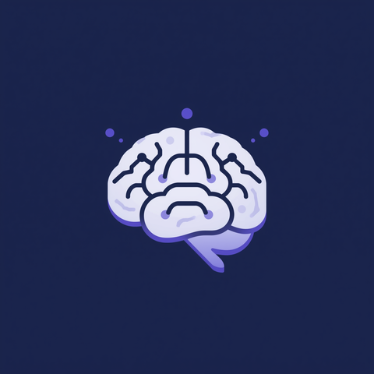

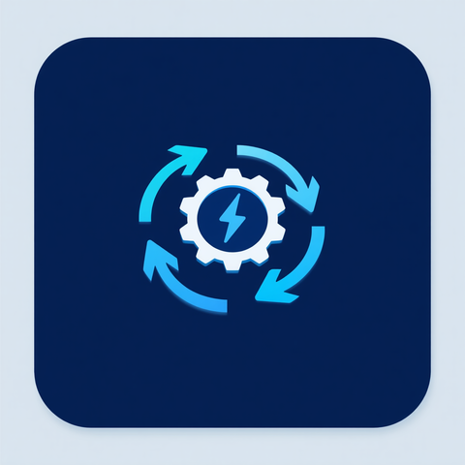
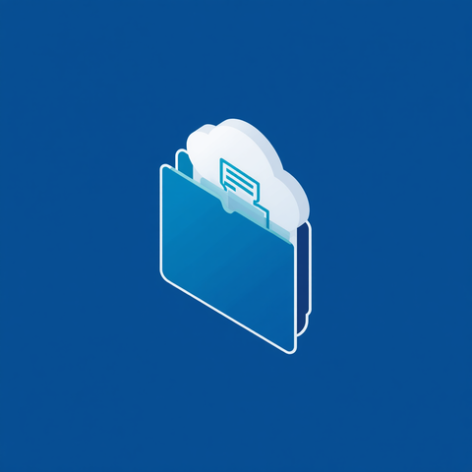
INFRASTRUCTURE ARCHITECTURE FOR AGENTIC AI HIRING SYSTEM
Copilot Studio
Core Agentic Layer
Dynamics 365 HR
System of Record
Power Automate
Workflow Engine
SharePoint
Document Layer

Slide 7

EXPECTED IMPACT & BUSINESS CASE
01
Time-to-Hire: 30-50% faster
The Agentic AI hiring system delivers measurable improvements across key performance indicators, transforming HR operations efficiency.
Recruiter Productivity: 40-60% manual work reduction
02
Candidate Experience: More transparency + quicker responses
03
Process Consistency: Standardized scoring & approvals
04
05
Analytics & Insights: Drop-off tracking, bottleneck analysis

Slide 8

TEAM: INFINITE LOOPERS
THANK
YOU
Capgemini Microsoft Global Partner Hackathon
INDUSTRY:
Human Resources
SOLUTION:
TECHNOLOGY:
Agentic AI Hiring System
Copilot + Dynamics 365

